Slide 1
DLS Town Hall
Notes:
Community talk –
Shared Values
Shared Experiences (restaurant …)
Shared norms … we all want what is best for kids
BOARD not focused on one kid or one year or one community. Focused on long-term health of the school.

Slide 2
Facilties and Transportation Update
History
Current Status
Near Term and Medium Term Projects
Questions & Answers

Slide 3
Our Goals as a Board
The best possible learning environment and outcomes for our students.
The best possible working environment for our faculty / staff.
Long-term and short-term viability of our school.
K-8 one location as the final outcome.

Slide 4
History

Slide 5
History
Not enough room for specials, classes, gym, lunch, KC, Fun Club, etc.
Operational challenges
Enrollment reductions and fiscal impacts
Notes:
What to sell k-8. Just mention that this initial vision was not arbitary

Slide 6
History Facilities Committee Work
Co-location
Purchase
Rental
?????
Notes:
There have been HUNDREDS if not THOUSANDS of hours spent by over 20 volunteers on this question in the last two or so years. The map above is just the key locations. The map with all locations is absurd! At least 50 locations pursued. We have spent three years searching for a solution in the NE.
We are limited financially.
There is a lack of viable facilities.
Fierce competition.
Whiteman campus not easily expanded.
Core issue – we either become smaller, or we find a second campus

Slide 7
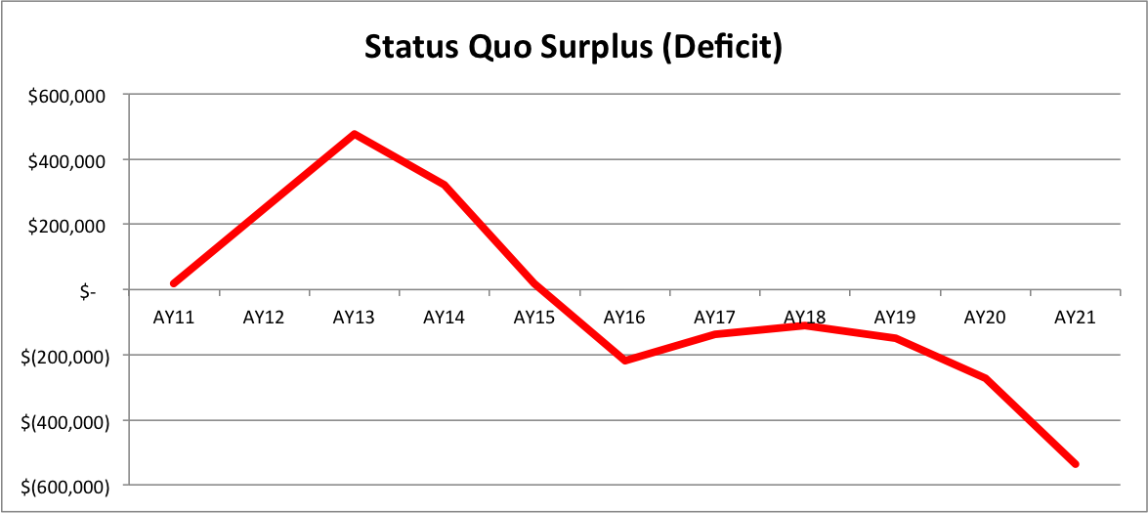
Stay with K2 Model
Notes:
It is not financially viable. We need that base. Have to have 4Ks to have a viable school, particularly middle school. Middle school numbers, across program start to get near 20 students in 8th grade across BOTH programs. Too small. Need a pyramid!

Slide 8
DLS West
Student enrollment increased by >125
4 classes of Kindergarten
Largely backfilled 1st grade
Full time gym teacher and programmed recess
Music Program through SNM
Gathering/performance space for the entire school
Repainted classrooms
Replaced windows, carpet, restrooms
Purchased furniture and equipment
Certified space for KC
Built out office space
Notes:
A lot of work has gone into getting DLS east ready to go. Anne Davis, Kathy and her entire administrative and teaching staff have accomplished…..\
45 out of 50 KC spots are filled providing service to our parents and relieving additional crowding at DLS East

Slide 9
DLS West
Permanent Playground and ballfields
HVAC Improvements
Improved coordination of shared spaces
Elevator Improvements
Notes:
Playground – end of October – ball fields –
Temporary swamp cooler units in upper level classrooms, window coverings, heat mitigation strategies Split system installation during summer break
Anne Davis and Assistant Principal Todd hired to help with coordination.
Elevator will have to wait for next year.

Slide 10
DLS East
Additional Classroom spaces:
1 for art
1 for technology
1 for science lab
1 for music (auditorium freed up)
1 for STEM or other courses
1 for advanced math
1 for pull outs
Middle school sports

Slide 11
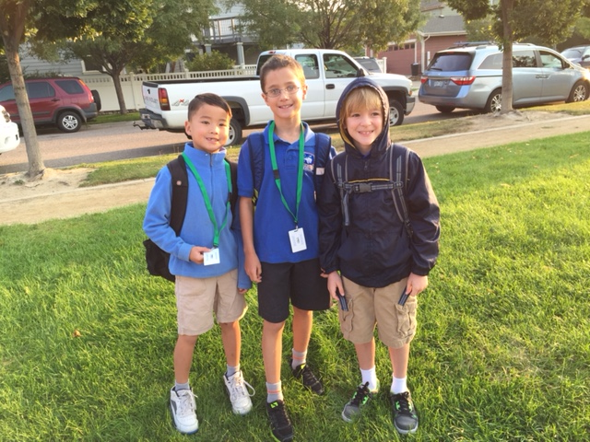
Transportation
>325 students served
Need continued patience and help from parents
PikMyKid rollout in late 2015
Notes:
4 bus routes to make transportation easier for a large majority of our populations – 325 students taking advantage of our bus services
East west and west east routes
Ridership numbers have been impressive – it has eased the pick up and drop off coordination which has helped our relationship with the neighborhood (good for LT plans)
There have been some hiccups which spurred the need for PikMyKid app. We are the first to roll this out in Colorado and received very favorable pricing.

Slide 12
Long-term Facility Update

Slide 13
Long-term Facility Update - Objective
Two K-5 campuses feeding 1 Middle School – possibly one K-5 and one K-8
Expand our base to maintain a robust Middle School

Slide 14
Current Options Being Explored
# 1: Whiteman as a K-5
Bond Application: if successful it would allow us to expand Whiteman to house all of our K-5 students
Timeline: Submitted first draft to DPS in Jan 2016. DPS will make final decision via DPS board and Bond committee

Slide 15
Current Options Being Explored
# 2: High Quality Middle School
Applying for High Quality Middle School status in order to relocate the Middle School program for 2017/2018 school year (possibly expanding middle school programming)
Timeline: waiting to find out when the RFP will be released for us to apply

Slide 16
Current Options Being Explored
#3: Alternative option: Private Company
Working with a private company who may be able to find us 1 building to house our middle school or future second K-8 campus for the DLS community 2017 and beyond
Timeline: we are at the mercy of this company’s ability to find us potential buildings and propose them to us.

Slide 17
DLS Trustees Development Committee

Slide 18
Development Trustees Co-Chairs
Co-Chair: Beverly Haddon
Co-Chair: Lisa Peloso
Founding Members:
Erin McLain
Amanda Shaw Newsome

Slide 19
2016 Goals
Expand DLS Trustees Development Committee to 15 members by March 31.
Pursue a planning grant that will cover the DLS Development expenses for 2016 by June 1.
Develop a Development Plan that will focus on raising funds for future facilities, by January 31.
Raise $1 Million for facilities in 2016.

