Slide 1
DLS Town Hall
Notes:
Community talk –
Shared Values
Shared Experiences (restaurant …)
Shared norms … we all want what is best for kids
BOARD not focused on one kid or one year or one community. Focused on long-term health of the school.

Slide 2
Outline for Tonight
Powerpoint Regarding History, Opportunities, and Challenges
Questions & Answers

Slide 3
DLS Charter
Proud to have DPS Support
No geographic limitations
Vision for the school K-8 – pedagogical reasons
Limits on capacity at Whiteman

Slide 4
Key Problem …
Notes:
We are running out of space!

Slide 5
Facilities Committee
Initially Formed in 2012 and led by Camilla Modesitt
Kenneth Ho became chair in 2013
Core group Kenneth, Irene Keeley, and Anne Davis.
Other Members:
Brooke Spencer
Jenny Petruno
Laurie Pace
Rich Naha
Heidi McKernan
Luke Wittemeyer
Ryan Hunter
Doug Elonowitz
Other Members:
Jesse Goldman
Huiliang Liu
Susie Grant
Sara Amodio
Moose Mamet
Angie Connor
Kristy Fantz
Corelle Spettigue
Notes:
Apologize for missing names!
Board members in bold and underlined. Not because they are special, but to highlight board involvement.

Slide 6
History Facilities Committee Work
Co-location
Purchase
Rental
?????
Notes:
There have been HUNDREDS if not THOUSANDS of hours spent by over 20 volunteers on this question in the last two or so years. The map above is just the key locations. The map with all locations is absurd! At least 50 locations pursued.

Slide 7
Key Moments
Notes:
Stapleton Build, Lowry Annex Build, Calvary Temple 1.0, Waldorf School
Explored partnership with Chinese Investors, but could create an economically beneficial relationship
Partnership formed with Urban Land Conservancy. This allowed us to make an offer on Waldorf and pursue two other campuses.
We have been creative, deligent and focused.

Slide 8
Board Vote Last Year
Evaluated CT for grades 4-8, eliminate middle school or reduced down to K2.
Various concerns around school stability how to project middle school attrition – empirical data showed significant attrition (~50%) at the middle school level.
Chose to enroll 2K’s
Best choice, by far, at that time
School more stable now

Slide 9
Our Goals as a Board
The best possible learning environment and outcomes for our students.
The best possible working environment for our faculty / staff.
Long-term and short-term viability of our school.
K-8 one location as the final outcome.

Slide 10
Summary Facilities Process
We have spent three years searching for a solution in the NE.
We are limited financially.
There is a lack of viable facilities.
Fierce competition.
Whiteman campus not easily expanded.
Core issue – we either become smaller, or we find a second campus

Slide 11
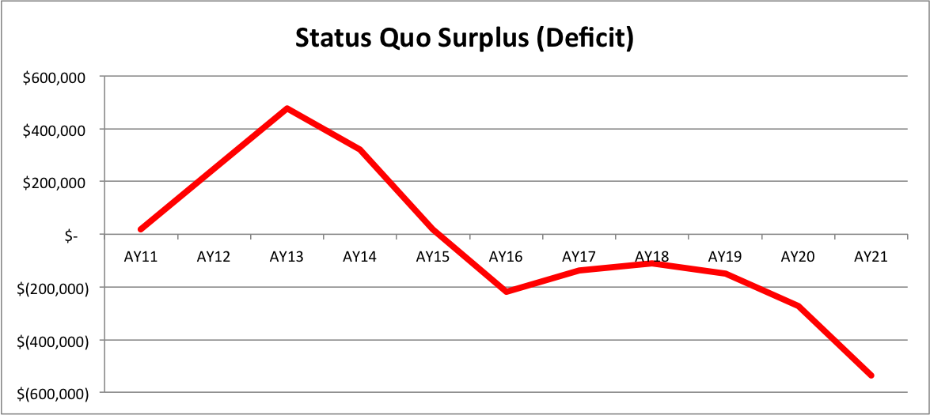
Stay with K2 Model
Notes:
It is not financially viable. We need that base. Have to have 4Ks to have a viable school, particularly middle school. Middle school numbers, across program start to get near 20 students in 8th grade across BOTH programs. Too small. Need a pyramid!

Slide 12
Foundation is the Key …
Notes:
Need to build our base …

Slide 13
Enter Calvary Temple ….
Here is why Calvary Temple is a great near-term solution for us!
Additional revenue.
Broader base to address attrition at higher grades.
Broader fundraising base.
Ability to bring in a diverse student population.
Avoids bubbles and bottlenecks in the future.
Socio emotional needs addressed
Notes:
CT allows us to go back to 4Ks and keep growing the school while figuring out a long term facility solution. We need more time and we have exhausted all other temporary solutions.

Slide 14
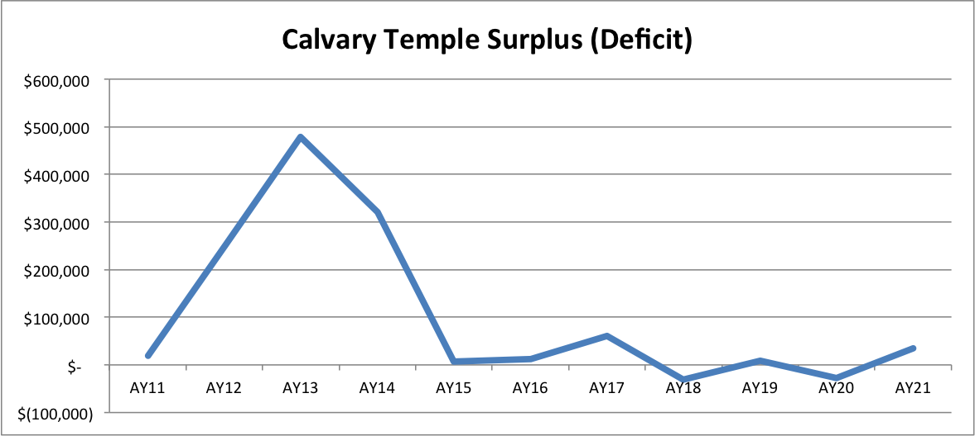
Calvary Temple
Notes:
Same initial surplus, plus short-term to medium-term viability. Gives us the base we need!
Conservative estimates. Drawn up by our CFO – Lori Deacon. Contingencies upon contingencies …

Slide 15
Plus ….
Teachers like it ….
More collaboration
No moving to “carts”
Already feeling cramped
We can back-fill 1st grade
We can make Whiteman a better Middle School
Notes:
The split would open up 10 classrooms, creating space for dedicated English classrooms, music, rising middle school grades and more. The relationship with the neighborhood should remain positive as a result. By returning the K-2 student base back to full build-out, this also provides the rising middle school with a larger student population.

Slide 16
Lease (Proposed) at CT
We have structured the lease specifically to allow us options.
The rent is a fixed price, not variable as with DPS
Very favorable rates
Includes following improvements / advantages:
We will have a 5 year lease with an option to extend the lease an additional 5 years beyond
We will have an early out option after 2 years in case it is not working
Notes:
Fixed price rent means we need to go K-2. Practically, we can replace folks. Price per pupil vs. fixed rate.

Slide 17
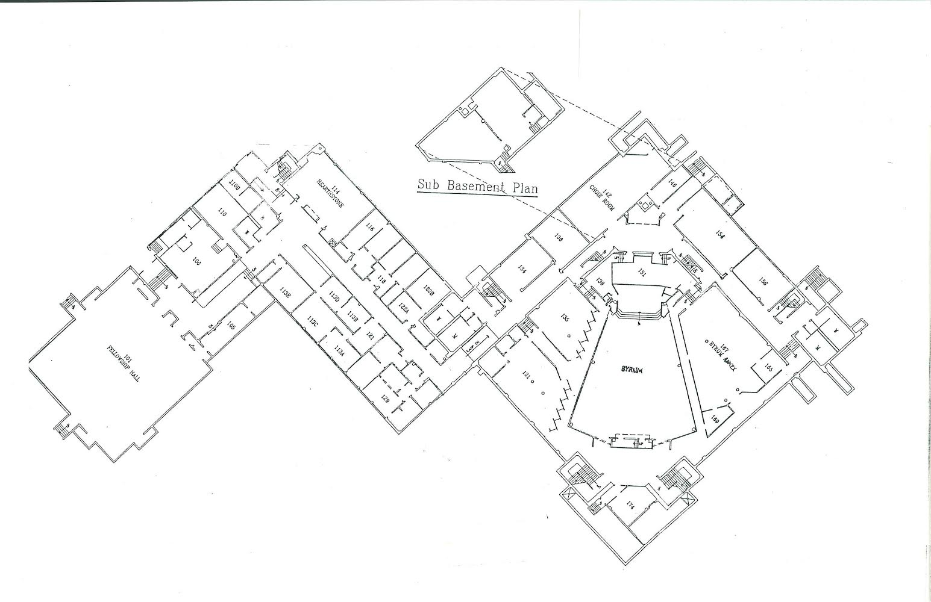
Calvary Current Plan – Lower Level
Notes:
4 k classrooms, admin office, teacher training, music ( sub-basement for pull out rooms potentially)

Slide 18
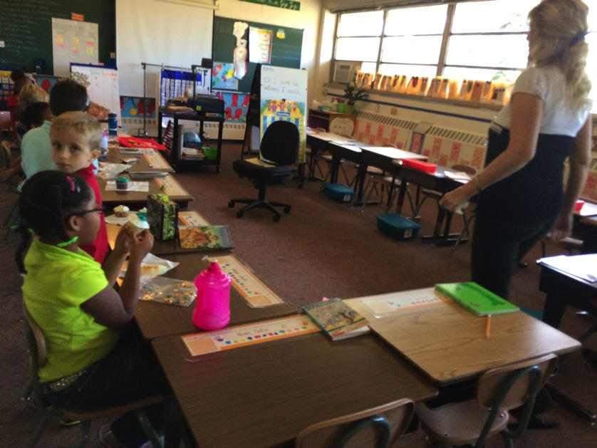
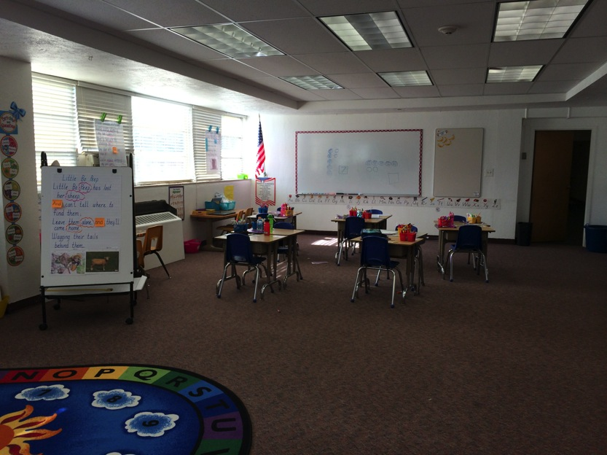
Calvary Temple Classroom Pictures

Slide 19
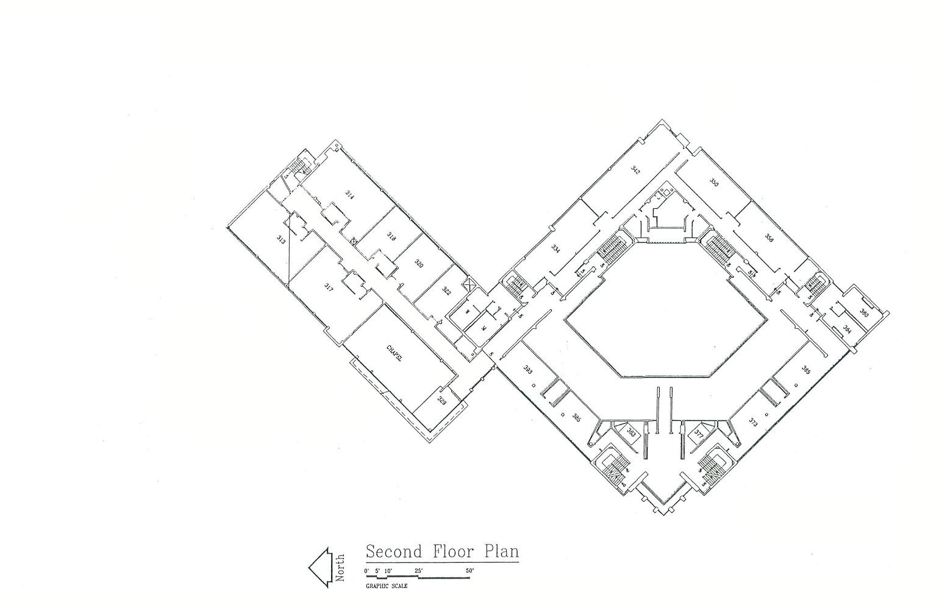
Calvary Temple – Upper Level
Notes:
All 4 1st grades and 2nd grades clumped together, Teacher lounge / workroom, special services, technology room, nurse station, reception, 2 more admin offices, art room, and open room.

Slide 20
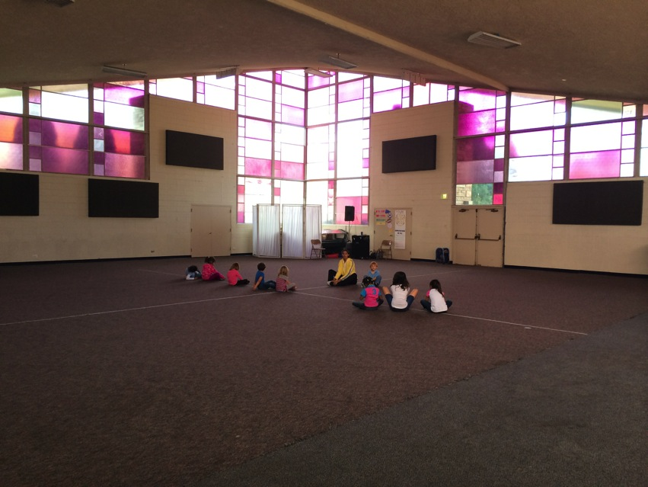
Flex Space
Notes:
Larger than WM gym, can hold PE there around lunch. Can do whole community for lunch in 90 minutes.

Slide 21
What about Whiteman?
4 dedicated English classrooms
1 for art
1 for technology
1 for science lab
1 for music (auditorium freed up)
1 for STEM or other courses
1 for advanced math
1 for pull outs

Slide 22
Transportation
Largest Concern
25% of our campus from Stapleton
Around $130,000 in the budget to address this concern
Will have staggered start times. Longer day at Whiteman to increase overall instruction.
Need input and volunteers
Need volunteers to serve on committees
Open to all ideas
The Model is Worth the Drive!
Notes:
10 minute drive. Do it repeatedly. My daily drive. (I won’t have kids there) Routes that avoid cherry creek traffic.
We will meet with DPS transportation next week
----- Meeting Notes (11/12/14 20:05) -----
concerns about transportation
kaidescope is wait listed
most is up in the air

Slide 23
Middle School
Key Commitment
Immersion Models
Key for fundraising
Better Suited for Whiteman (gym, additional facilities)
Financially a better fit
Notes:
MS bad fit financially
MS bad fit structurally
$550 per student (estimate) at Calvary – can replace attrition
$740 per student (estimate) at Whiteman – per pupil, so less risk.

Slide 24
We Can Take a Deep Breath
Gives us a change to move forward in a state of stability
Fundraising
Long-term solutions
Better focus
Notes:
Kathy supports this. Administrative team supports this.

Slide 25
Board Commitment
Notes:
Key moment to promise to behave professionally plus pre-empt some parent concerns

Slide 26
Next Steps
Tours at Calvary Temple
Board phone calls with concerned families
Survey regarding move
Committee Formation

